Slide 1




JAVA TRAINING - BATCH V
CODE.ID
OOAD/OOP STRUCTURE ON GITHUB LIBRARY
PRESENTS BY BAGUS AND MENTARI

Slide 2

Charateristics of OOAD/OOP
ABSTRACTION
ENCAPSULATION
classes that are still abstract or unclear. because of its abstract form, it can't be made directly into OBJECT.
class wrapping; either method or attribute, so it can't be accessed by other classes.
INHERITANCE
POLYMORPHISM
class that can pass its properties and methods to another class.
method that has many forms.

Slide 3
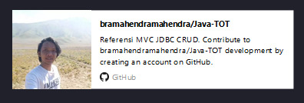
the library and the author
We used Mysql JDBC Driver library from github
https://github.com/bramahendramahendra/Java-TOT/tree/master/src

Slide 4
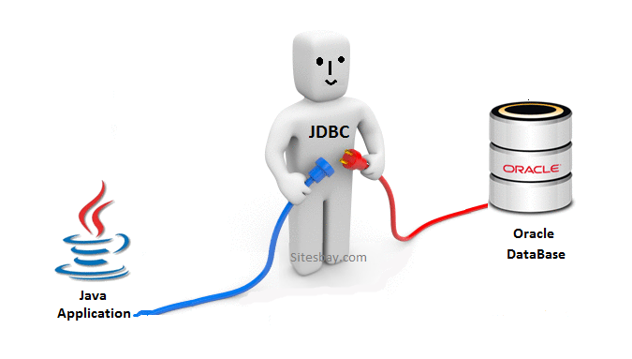
JDBC
JAVA DATABASE CONNECTIVITY
is an application programming interface (API) for the programming language Java, which defines how a client may access a database. It is a Java-based data access technology used for Java database connectivity. It is part of the Java Standard Edition platform, from Oracle Corporation.

Slide 5
CRUD
WHAT IS IT?
CRUD stands for Create Read Update Delete, which are often used in applications that most of the data processing mengguanakan CRUD functions therein. This function is used to add data, delete data, and update data.

Slide 6
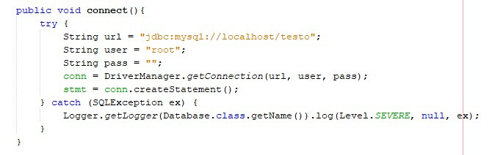
Initialization of database
Initialization of database

Slide 7

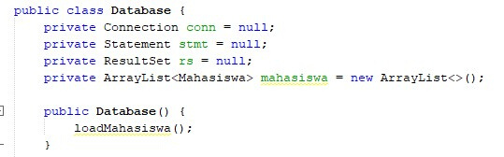
Encapsulation

Slide 8
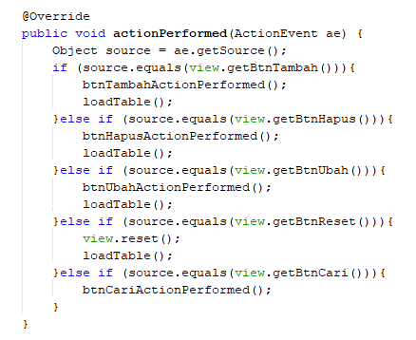
Polymorphism

Slide 9
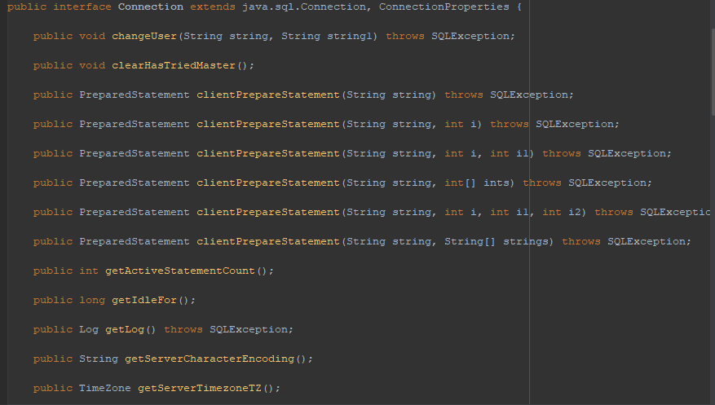
Pada program ini menggunakan class Connection.java dari libraries JDBC package com.mysql.jdbc
Yang berfungsi sebagai pengkoneksi SQL ke java application.

Slide 10
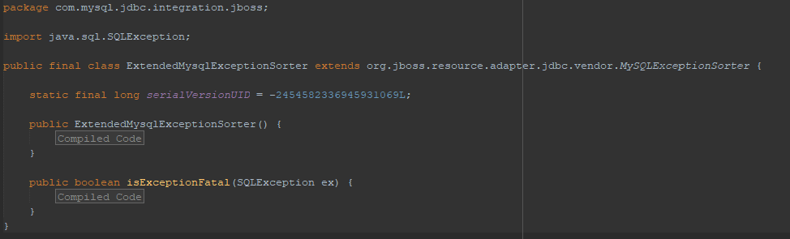
An exception that provides information on a database access error or other errors.

Slide 11
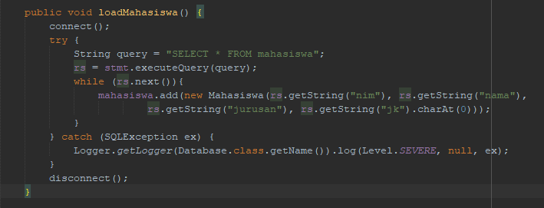
To execute SQL statement

Slide 12
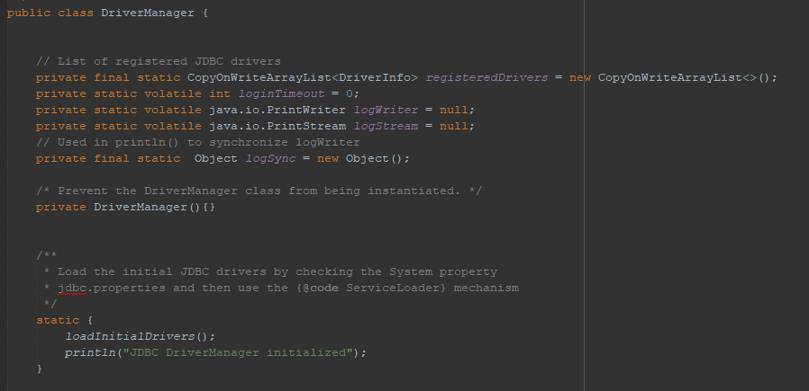
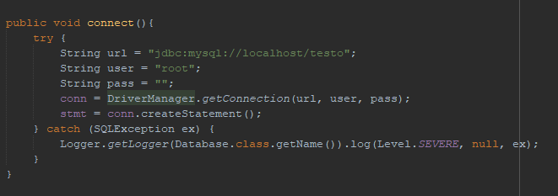
Load the initial JDBC drivers by checking the System property jdbc.properties and then use the

Slide 13
CONCLUSION
JDBC is one of the useful libraries that the most frequently on java development because the function that can connect java application with a database as the name suggests is Java Database Connection.

Slide 14

Thank you for your attention
FEEL FREE TO ASK AND GIVE THE ADVICE
AAI | Pro X

